Slide 1
MyCityApp
Presented by:-AndroGuys

Slide 2
Problem:LS2
1
Providing public with a platform where all the information and services publically available are one click away.

Slide 3
About Product
Main features provided by our are as follows
Travel
Dynamic weather updated
Trending Events in MyCity
Nearby services

Slide 4
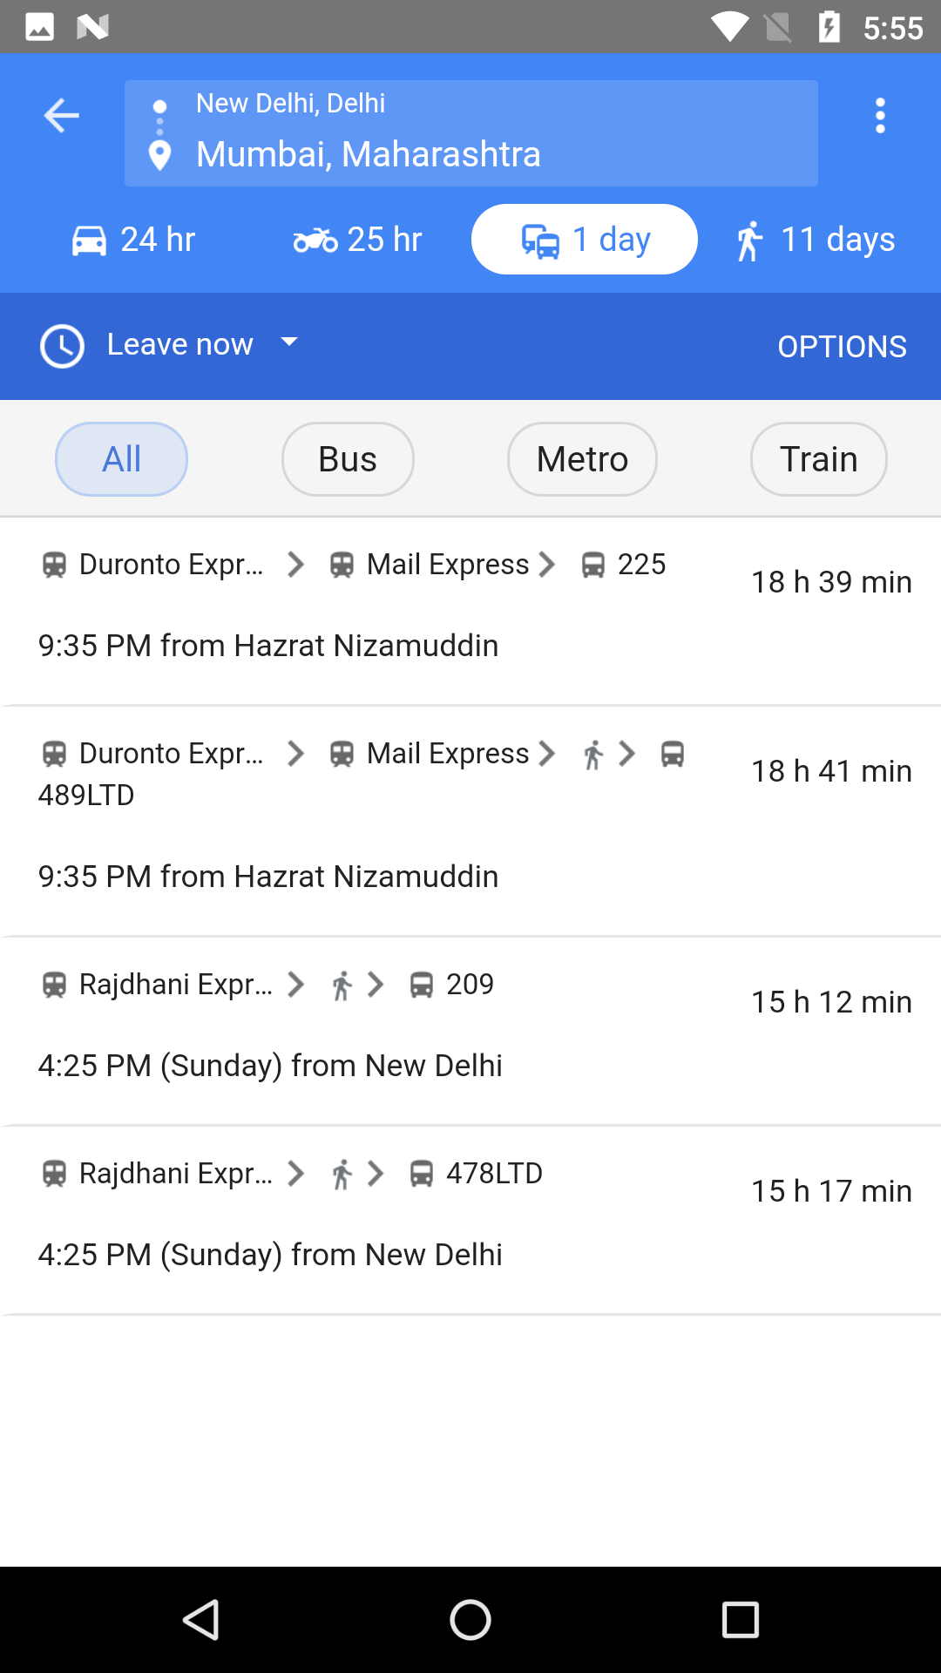
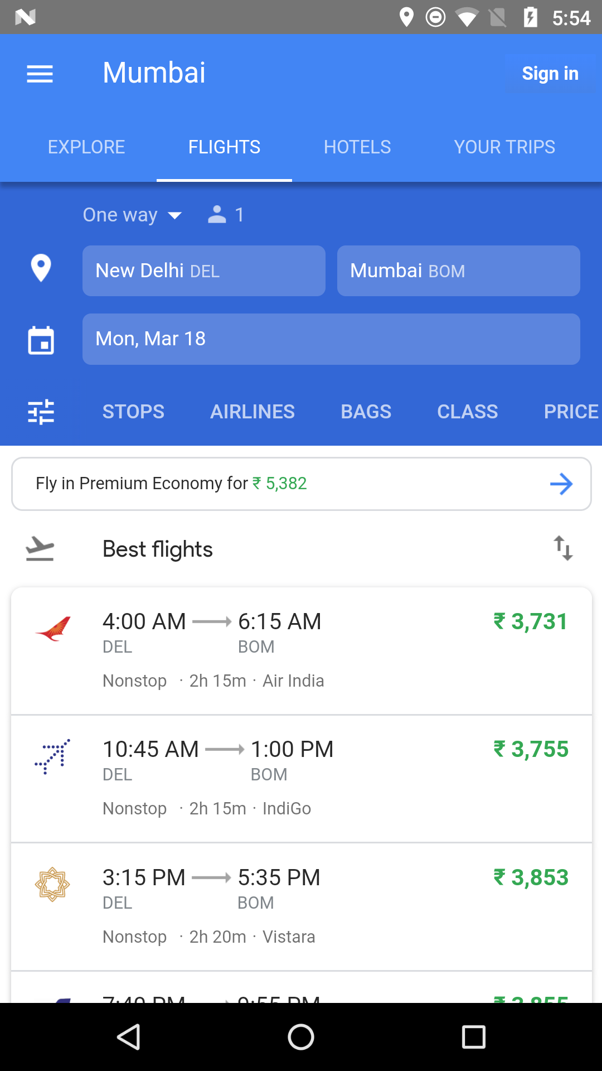
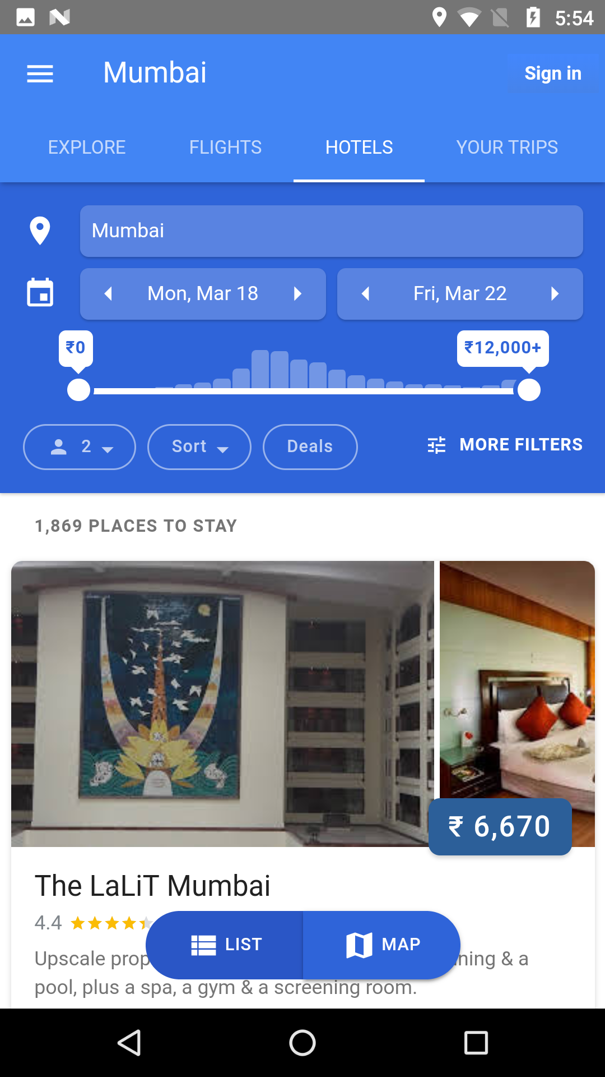
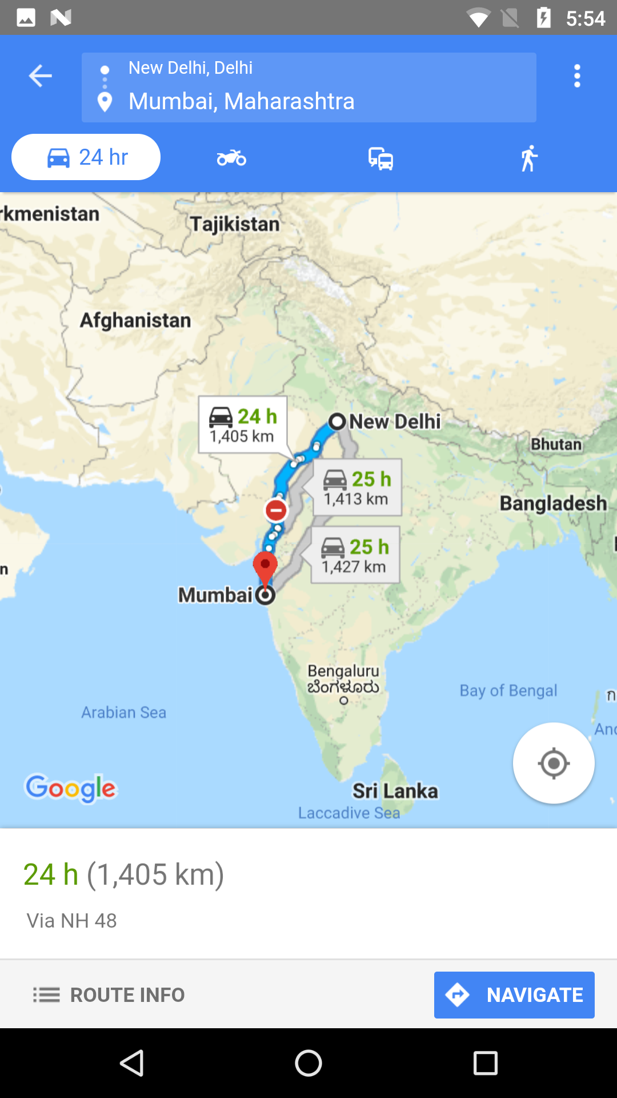
Travel
After setting the source and destination user may choose between the modes of transport along with other amenities like hotels .References like ratings and reviews will be provided to help user get the their worth of money

Slide 5
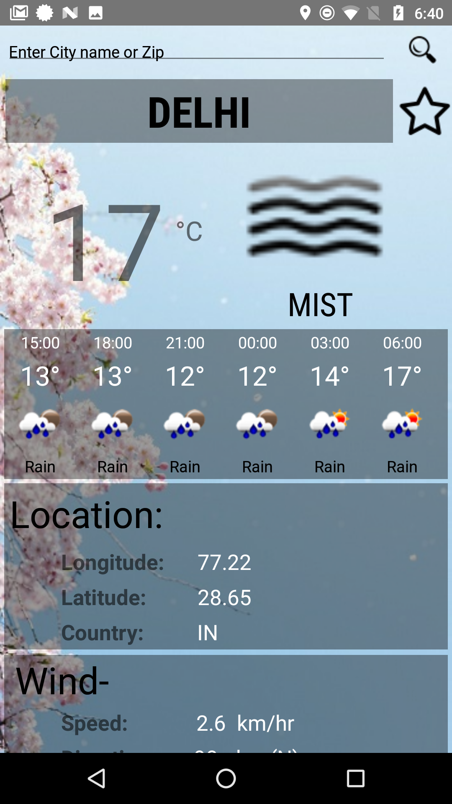
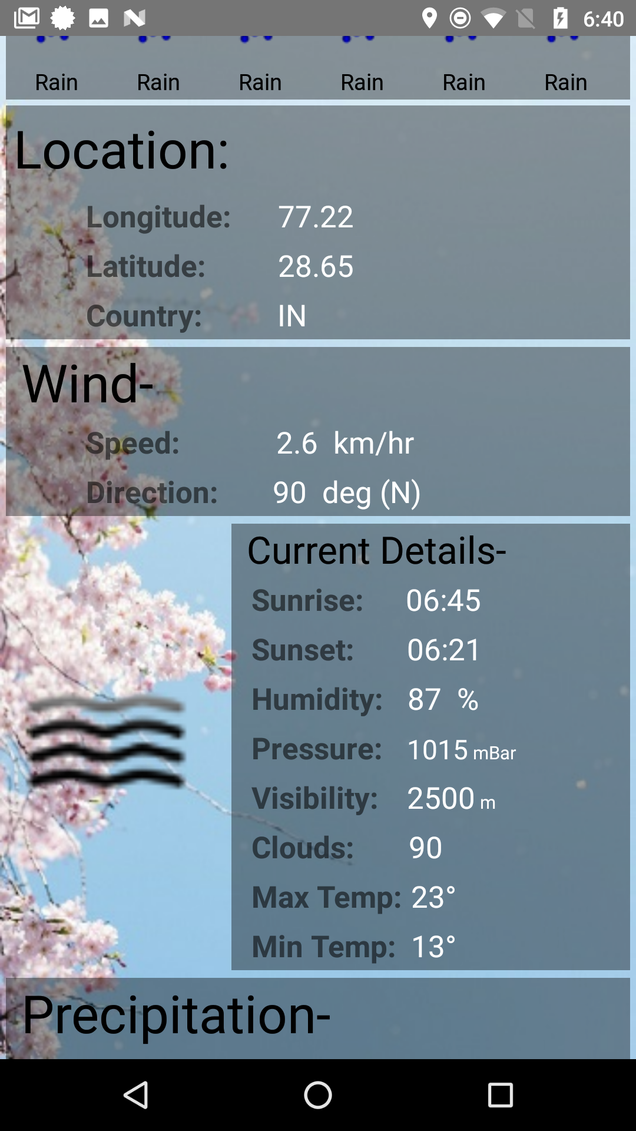
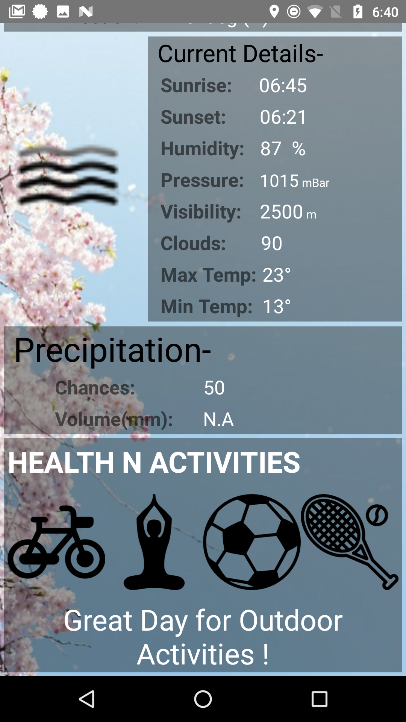
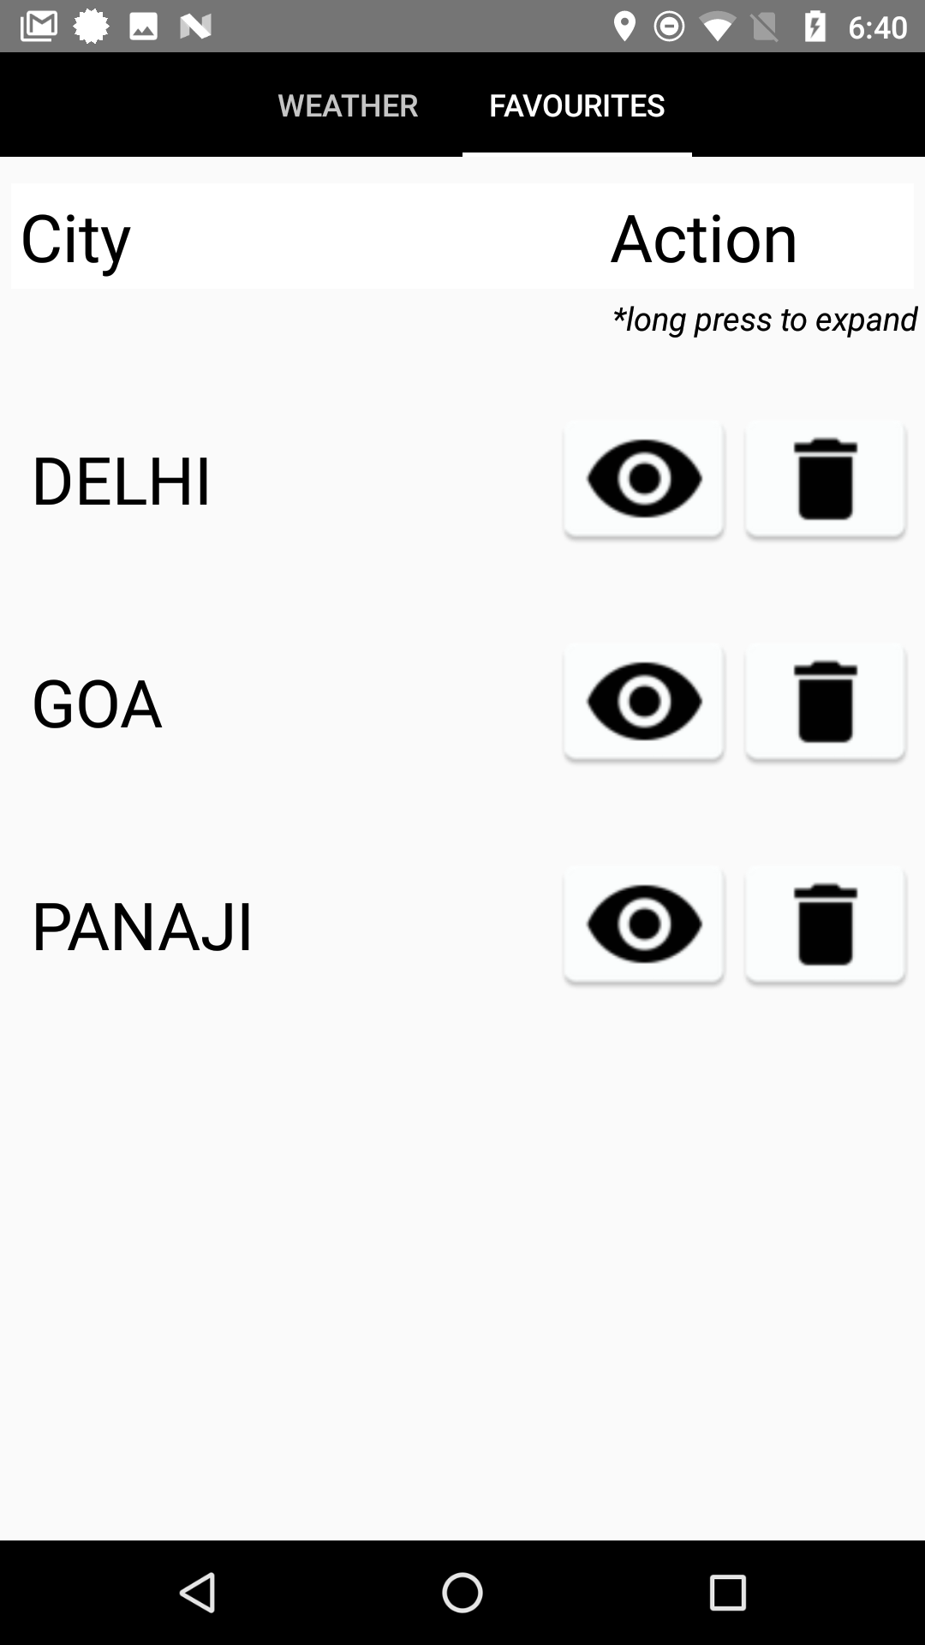
Weather
User may check weather of various cities along with various other factors like wind speed, humidity , visibility etc.

Slide 6
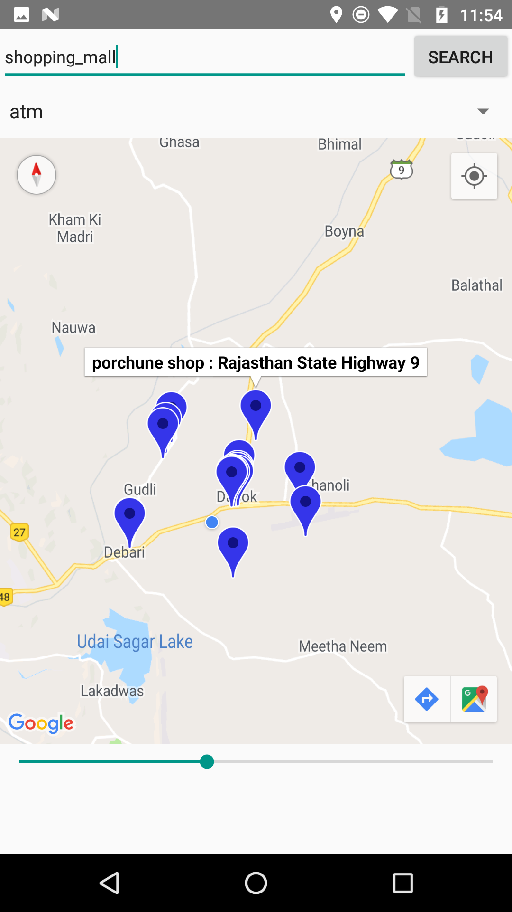
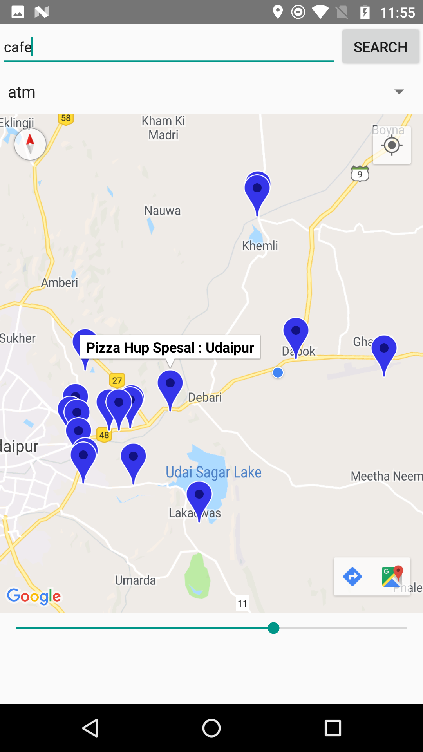
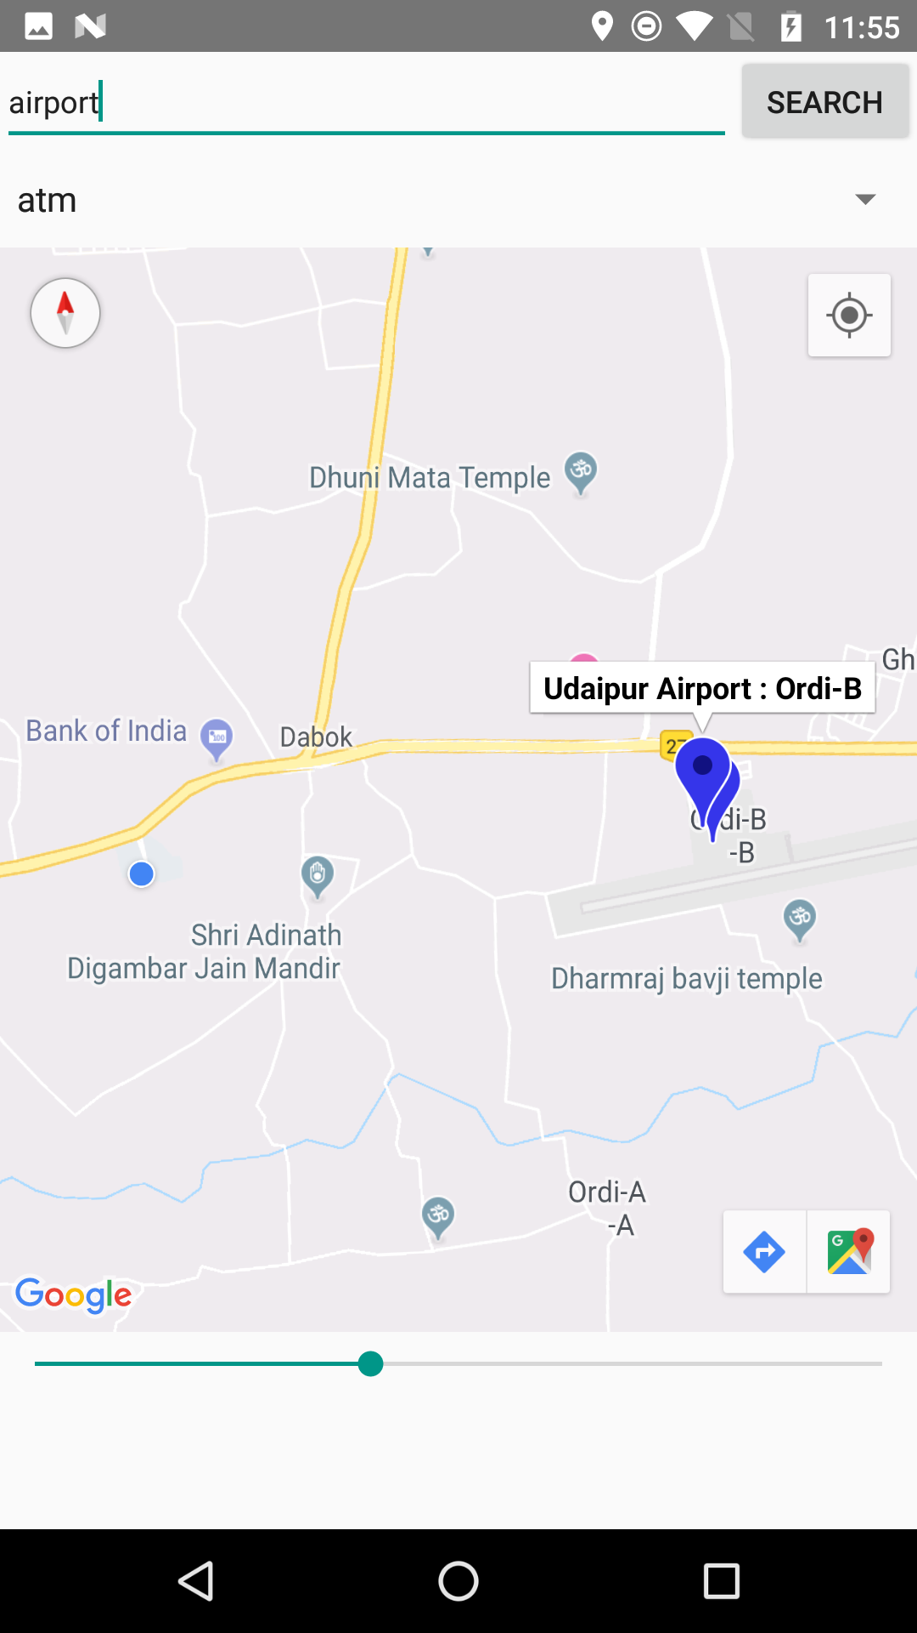
Nearby Services
Many services are provided to us at a reasonable price which many times are rendered useless simply because the user is not aware of how and where these can be found

Slide 7
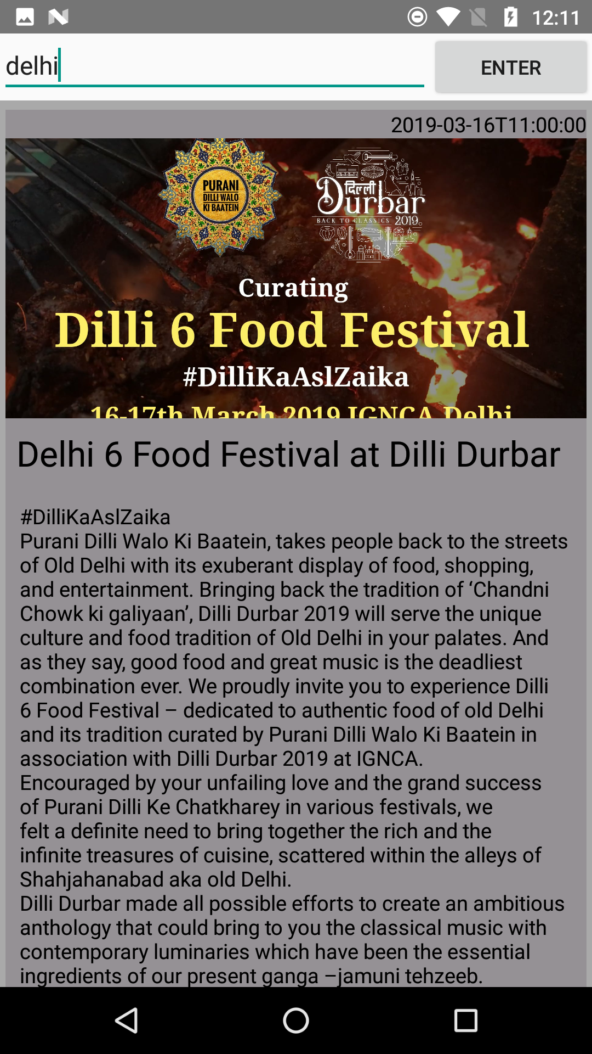
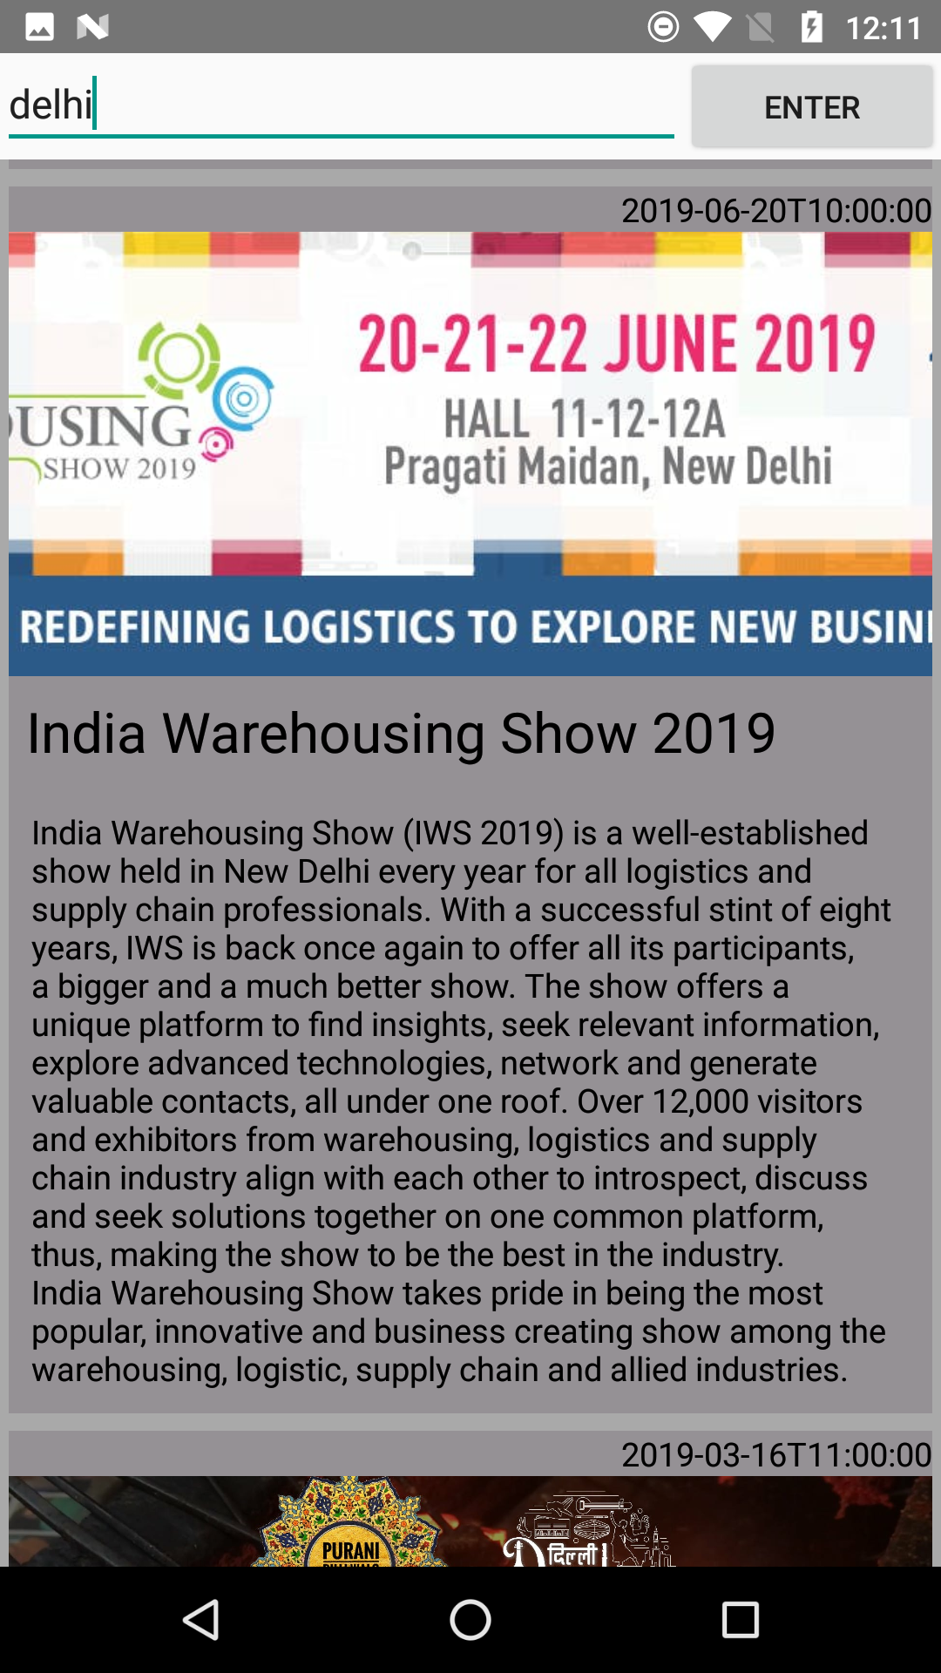
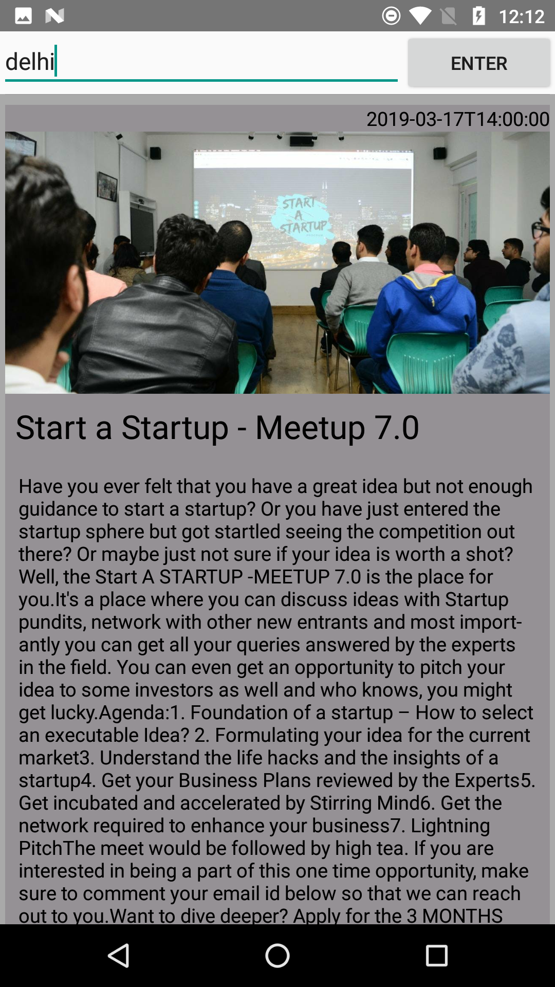
Events
Humans can endure anything but boredom and its ironic how many of us have to go through this despite the fact that modern cities are steaming with fun activities .Our team hopes to make sure that no one ever feels bored again with our features .

Slide 8

Some other features of MyCity
Forex Currency exchange
Accident Detector
GovtPhonebook
Pollution Check

Slide 9
Technology Stack
Trusted Source
Authorized API
App Data

Slide 10
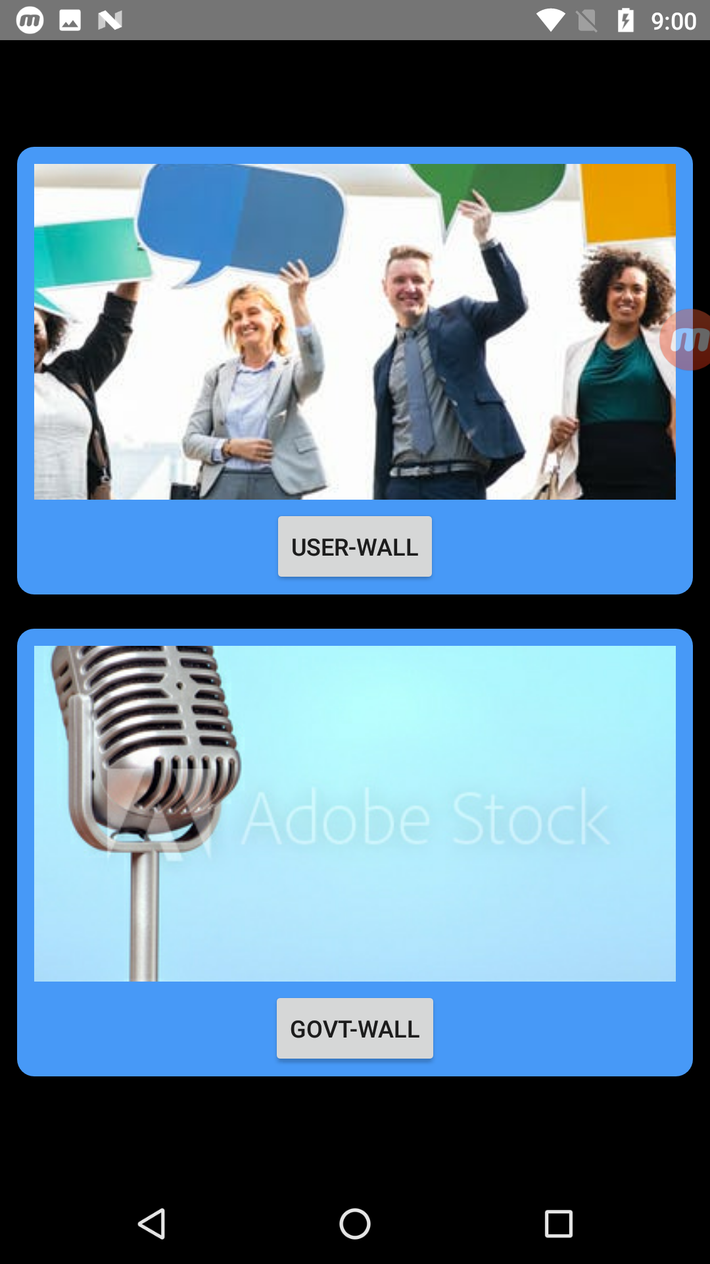
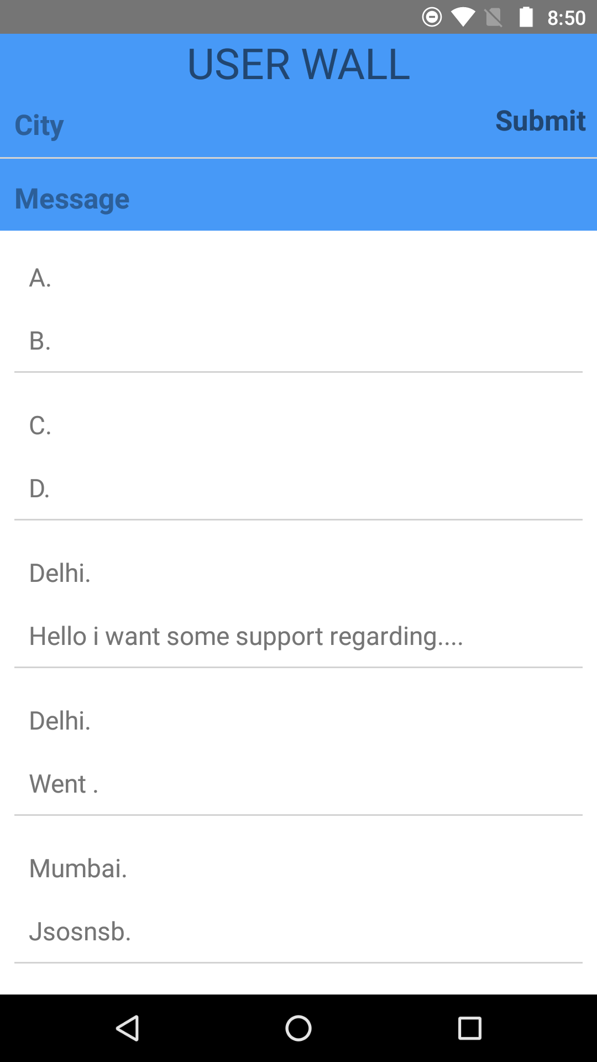
Why our app is better than any other online platform

Slide 11
Possible Markets to Expand in
~16 Lakh Crore
~80
Lakh
~20
Lakh
Revenue Generated
by tourism
Flights booked every
month
People Boarding metro in
Delhi during festivities

Slide 12
Acknowledgement
Efforts by:
Mr.Yogesh Sharma(Mentor)
Dr. Deepak Gupta(Mentor)
Rajat Jain (Team Leader)
Apoorv Garg(Member)
Deepanshu Jindal(Member)
Nitin Singla(Member)
Shonima Minhas(Member)
Rambir Singh(Member)
Data and statistics used in the presentation were approximated from the following sites
www.google.com/search?q=revenue+generated+by+tourism+in+india&rlz=1C1NHXL_enIN767IN767&oq=REVENUE+GENerated+by+tourism+in+india&aqs=chrome.0.69i59j69i57.4238j0j9&sourceid=chrome&ie=UTF-8
www.quora.com/How-many-people-travel-daily-via-a-flight-in-India
http://www.delhimetrorail.com/press_reldetails.aspx?id=D56csDWRltIlld

Slide 13
That will be all for now stay tuned for further updates
Thank You…

